Slide 1
MAC Protocols in Nuclear Power Plants
Junaid Alam
Ramprasad Beerappa
Bilal Amjad

Slide 2
Overview
Nuclear Power Plants
Wireless Sensor Networks
MAC Protocols
LEACH Protocol for WSN
Performance and simulation results
Conclusion and Q & A

Slide 3
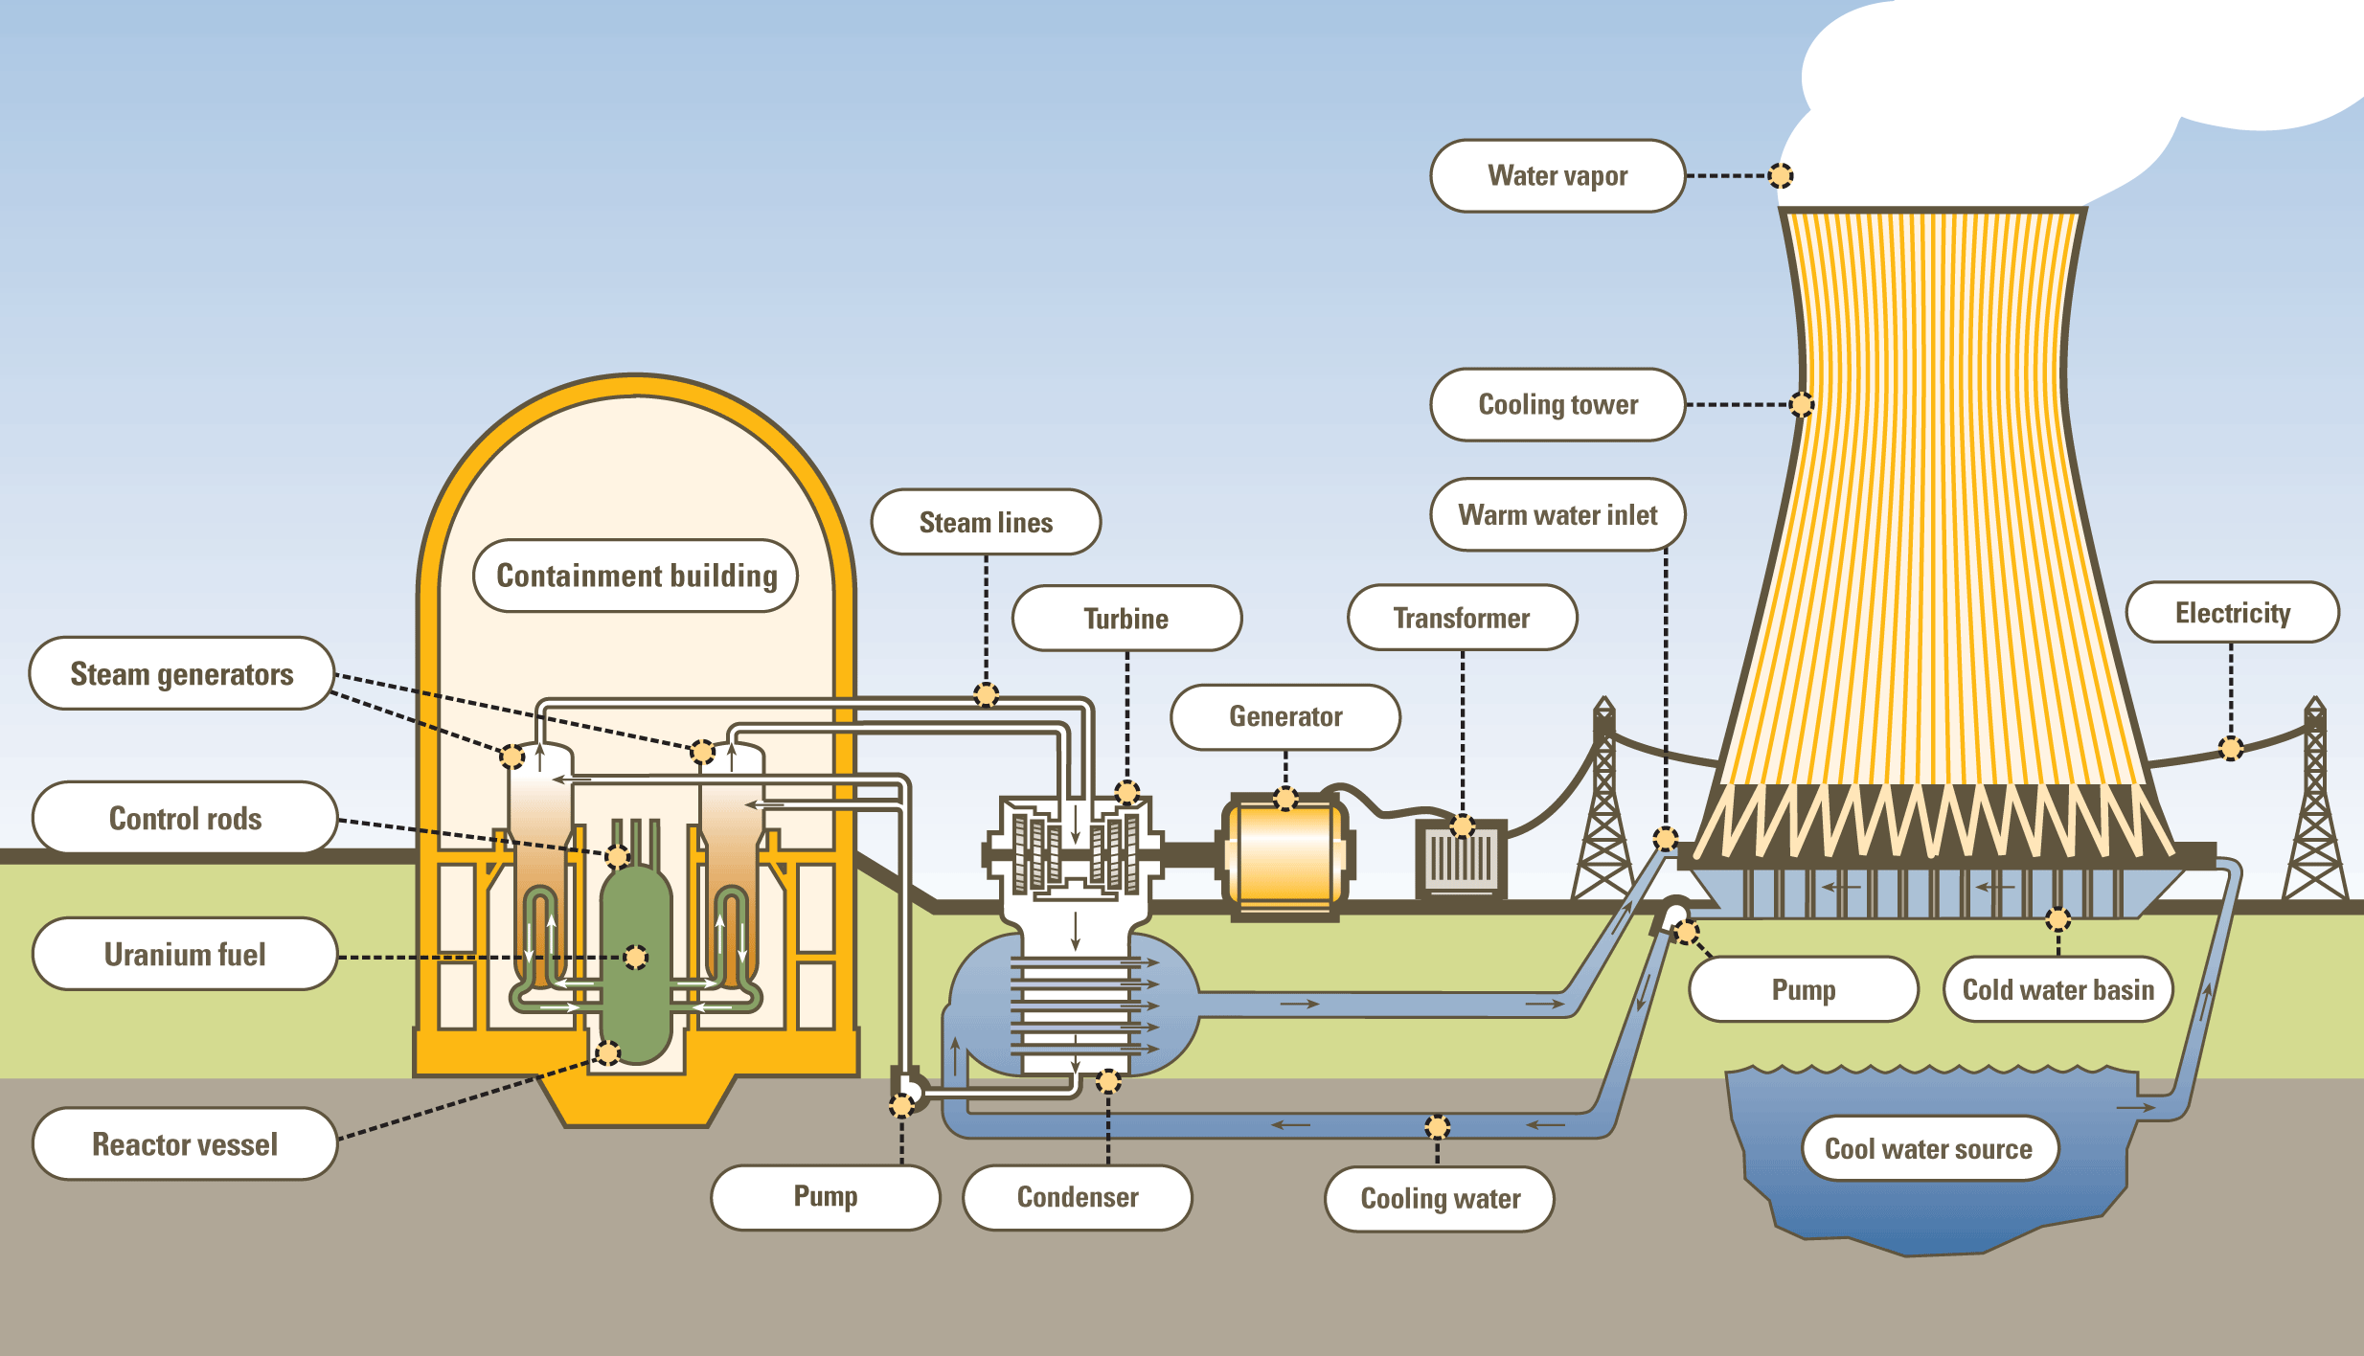
Nuclear Power Plant

Slide 4
Sensor nodes and WSN
Senses data from the environment
Transmit data to a collecting node
Do not have pre-defined network infrastructue
deploy in ad-hoc fashion
Nodes are power constrained
Node can join or leave network independantly
Thousands of nodes use the shared channel for data transmission
Proper routing and MAC protocol needed

Slide 5
MAC Protocols
Data collision occurs when multiple nodes transmit data at same time using shared medium
MAC protocol is used for fair use of shared medium by multiple nodes
Schedule based protocols
TDMA, FDMA, CDMA
Contention based protocols
ALOHA, CSMA
Hybrid of Schedule based and Contention based protocols exist
ER-MAC, H-MAC etc

Slide 6
TDMA - schedule based MAC protocol
A frame is divided into N number of time slot
Each node is allocated one time slot
Node uses the shared channel in its allocated time slot (ONLY)
Node can use whole available bandwidth in its time slot
Node needs to wake up only in its time slot. (Power saving!! )
No or little data collision
Strong time synchronization is necessary
Cannot adapt to frequent changes in network topology

Slide 7
CSMA - contention based MAC protocol
Nodes compete for the shared channel
Senses the medium before transmitting data
Transmit if the medium is idle, otherwise try again later
Hidden terminal and exposed terminal problem exist
Does not require time synchronization and knowledge of network topology

Slide 8
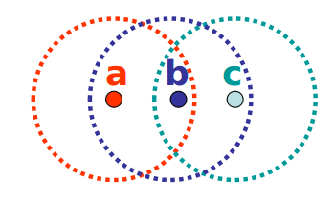
CSMA - Hidden Terminal problem
node A hears node B, but not node C,
node C hears node B, but not node A
node B hears both
node A sending data to node B, node C also want to send data to node B
node B senses channel, channel is idle
node C send data to node B.
COLLISION occurs at B
node A is hidden to node C

Slide 9
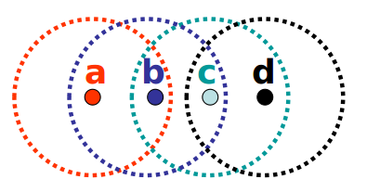
CSMA - Exposed Terminal problem
node B sending data to node A
node C want to send data to node D
node C senses medium, medium is busy
node C retreats
in Exposed terminal, medium is under utilized
Different version of CSMA exist
1 persistant, n-persistant
CSMA-CD, CSMA-CA

Slide 10
Wireless Network and Wireless Sensor Network
Wirelss Network | Wireless Sensor Network
It has fixed network topology | It does not have fix topology
Nodes are single hop away fron base station | Nodes can be multi hop away from collecting node
Nodes are usually rechargable | Nodes are power constrained
Data redundancy is low | Data redundancy is high

Slide 11
MAC Protocols for WSN
Existing MAC for wireless network are not suitable without modification
WSN MAC protocols must have following properties:
Collision avoidance
Energy Efficiency
Scalability and Adaptivity
Fairness
Throughput
Latency

Slide 12
MAC Protocols for WSN
WSN MAC protocols must avoid following:
Packet collision
Overhearing
Idle listening
Over emitting

Slide 13
LEACH Protocol
A low energy, self adaptive and self organized cluster protocol
Based on shceduled based protocol TDMA
Nodes are organized into clusters. Each cluster has a cluster head and cluster member nodes
Cluster head is selected either by using distributed algorithm (LEACH)or centralized algorithm (LEACH-C)
LEACH operation is divded into two phase
Setup state phase - cluster head selection
Steady state phase - data transmitted to cluster heads

Slide 14
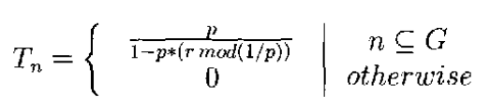
LEACH- Setup Phase (Distributed)
A distributed algoritm is used to select cluster heads
Each node pick a number between 0 and 1 and compare the number with a treshold value T(n)
If the number is less than T(n), the node become cluster head for that round, otherwise become common node.

Slide 15
LEACH-C Setup Phase (Centralized)
A centralized algorithm is used to select cluster and cluster heads
Nodes send location and energy inforamtion to collecting node (CN)
CN computes average node energy and nodes with lower enery cannot be cluster heads
CN computes k optimal clusters and cluster heads
CN broadcast a message containing cluster head ID for each node.
If the node ID and cluseter head ID is same, the node become cluster head; otherwise non cluster node.

Slide 16
LEACH- Setup Phase
Cluster head setup a TDMA schedule and transmit this schedule to the nodes in cluster
TDMA allows none cluster head nodes to turn off the radio components all the time expect during their transmit time
Turning radio components save energy and void idle listening
The Setup phase is completed once all nodes in the cluster know TDMA schedule

Slide 17
LEACH - Steady State Phase
Steady state is same for both LEACH and LEACH-C
This phase is much longer than Setup phase
Sensing data are transmitted in this phase
Each node transmit data to its cluster head in its time slot
After receiving data from all nodes, cluster node perform data processing and send aggregated data to collecting node
Data aggregation reduce data transmit size as most of the data in a cluster are redundant.

Slide 18
LEACH- Steady Phase
To void intra-cluster collision, each cluster is assigned with uniqe spreading code.
Each node in a cluster transmit data to cluster head using this spreading code
Cluster head treansmit data to collecting node using a fixed spread code of collecting node and CSMA.
Cluster head sense the channel if any one is tranmitting data using collecting node's spread code.
Transmit data if channel is idle, otherwise wait and try again later.

Slide 19
Performance of LEECH
Minimizes global energy usage by distributing the load to all nodes at different time
Totally distributed, do not need central control
Reduce redundant data by performing data aggregation

Slide 20
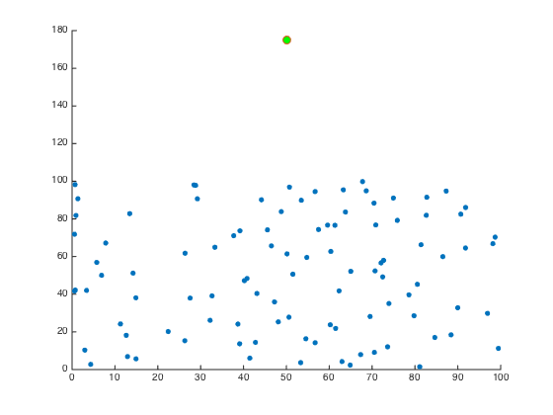
Simulation Results

Slide 21
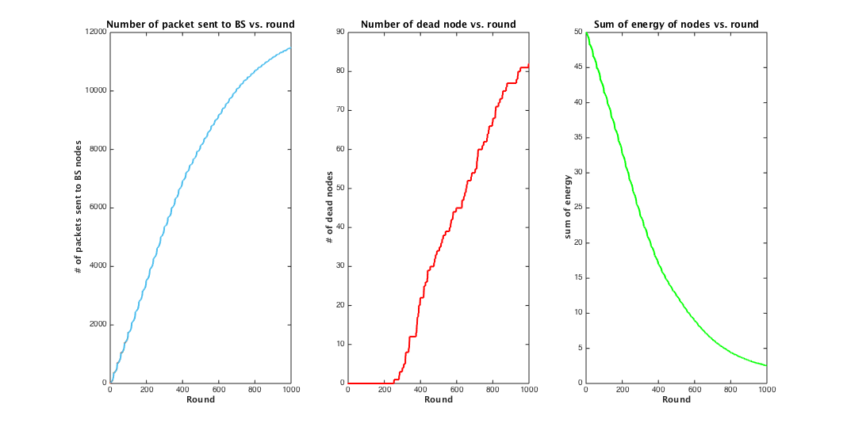
Simulation Results

Slide 22


